Slide 1
Topic: Percentage off EQ: How do I calculate percentage off?
Year 11 Essentials

Slide 2
Things Required For This Lesson
Interactive Notebook
Textbook: Interleaved Maths Essential Connections
Ruler, Red Pen, Pencil, Pens, Scientific Calculator
Growth mindset

Slide 3

24
7
30
Topic: Percentage off
Date: /03/2021
EQ: How do I calculate percentage off?
WICOR
This Photo by Unknown Author is licensed under CC BY-SA

Slide 4
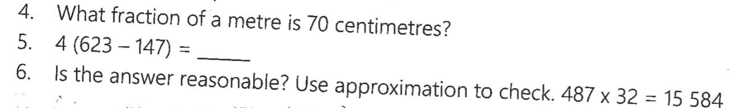
Topic: Percentage off
EQ: How do I calculate a percentage off?

Slide 5
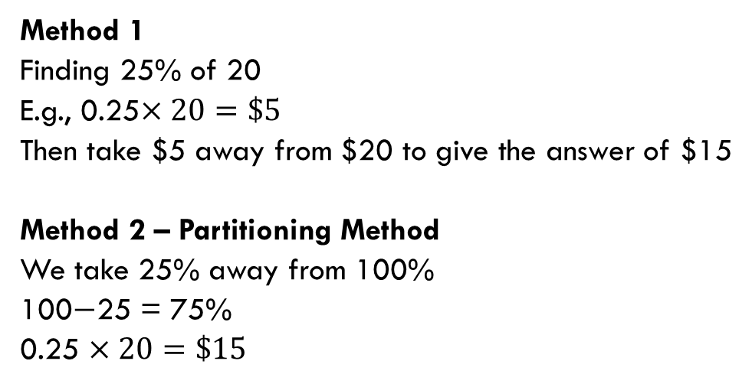
24
7
30
Topic: Percentage off
EQ: How do I calculate a percentage off?
How to use the partitioning strategy for 25% off $20?
Method 1
Finding 25% of 20
E.g., 0.25$×20=\$5$
Then take $5 away from $20 to give the answer of $15
Method 2 – Partitioning Method
We take 25% away from 100%
100$−$25 = 75%
0.25 $×20=\$15$
WICOR

Slide 6
Think pair share
What percentage discount was given if a shirt now costs $45, reduced from $50
Whole: 100% of the cost was 50
Part: Sale price is $45 What percentage is this? | Discount: $____? What percentage is this?
Notes:
Discuss partitioning strategy – breaking up a rectangle into parts shows that the discount is 5 out of 50 which calculates to a 10% discount

Slide 7
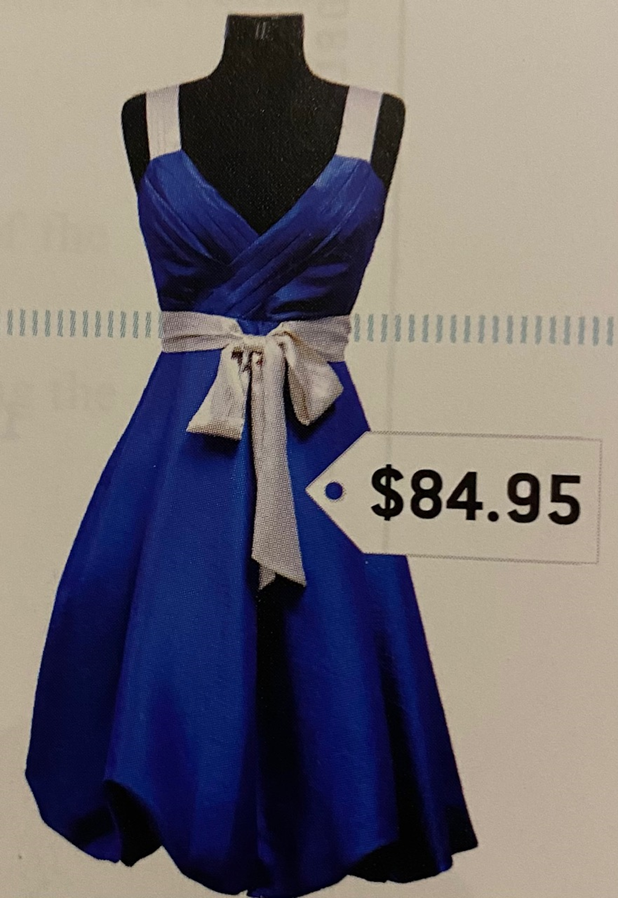
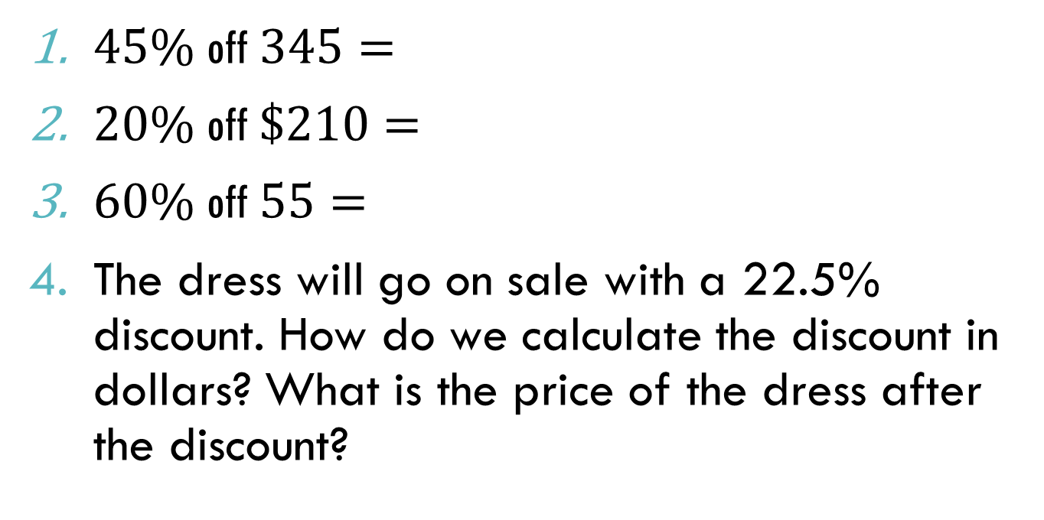
Practice:
$45\%$off$345=$
$20\%$off$\$210=$
$60\%$off$55=$
The dress will go on sale with a 22.5% discount. How do we calculate the discount in dollars? What is the price of the dress after the discount?

Slide 8
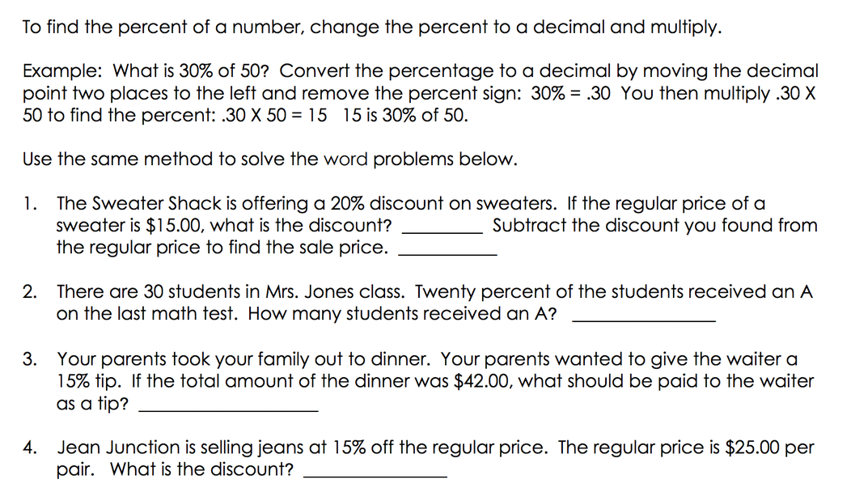

Slide 9
Practice: Complete SET A and B on Page 29 of the textbook

Slide 10
Exit Pass
What is the difference between percentage of and percentage off?
Use the following example: 45% of $90 and 45% off $90

Slide 11

Thank you
Keep up the good work!
"Success is no accident. It is hard work, perseverance, learning, studying, sacrifice and most of all, love of what you are doing or learning to do.“
-PELE

